Slide 1
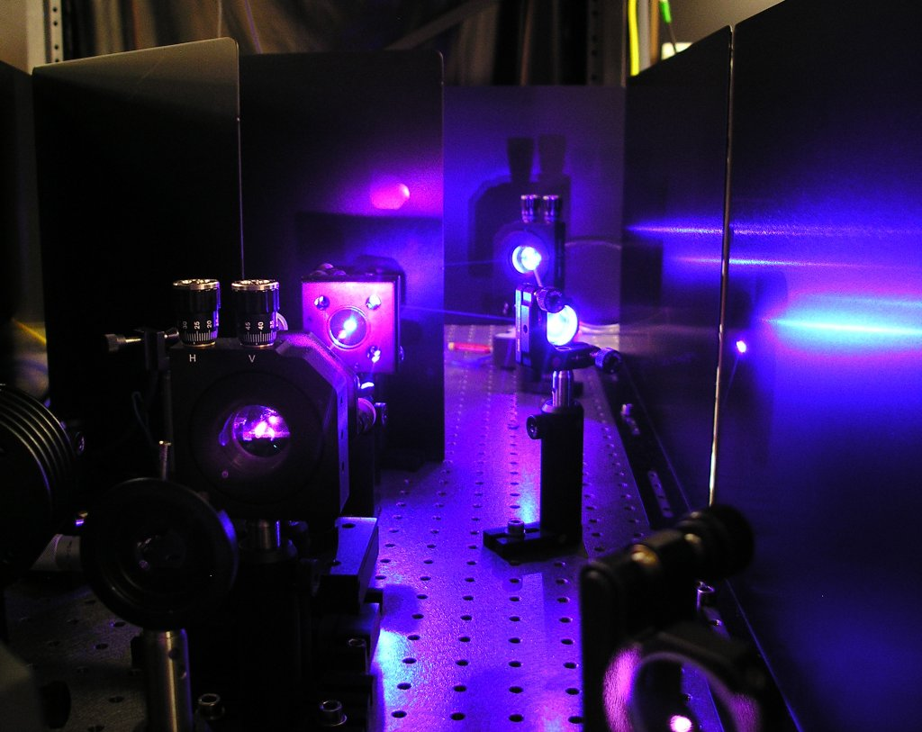
The stochastic Heisenberg limit
Dominic Berry
Macquarie University
Michael Hall
Howard Wiseman
Griffith University
arXiv:1306.1279

Slide 2
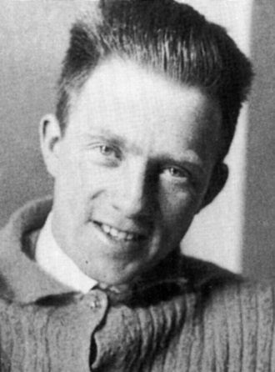
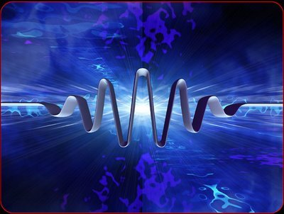
The Heisenberg Uncertainty Principle
position & momentum
quadratures
$$ΔpΔx≥\frac{h}{2}$$
$$ΔXΔY≥1$$
Werner Heisenberg
$$Y$$
$$ΔY$$
$$ΔX$$
$$X$$

Slide 3
The Heisenberg limit vs the standard quantum limit
The Standard Quantum Limit
If the two uncertainties are equal.
Uncertainty scaling
The Heisenberg Limit
If one uncertainty is reduced as much as possible.
Uncertainty scaling
$$Y$$
$$Y$$
$$ΔY$$
$$ΔX$$
$$X$$
$$X$$
$$Δφ∝1/\sqrt{N}$$
$$Δφ∝1/N$$

Slide 4
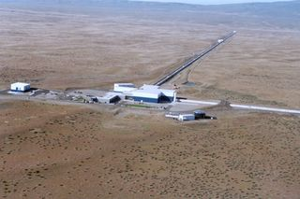
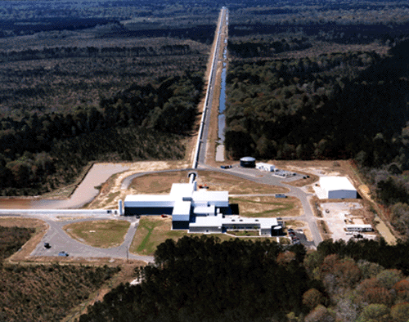
Why do we care?
4 km
LIGO
strain sensitivity
$$\sim 10−21$$
Circulating power $\sim 10−20$kilowatts.
Heisenberg limited measurements would require only nanowatts.
In reality loss prevents this.

Slide 5
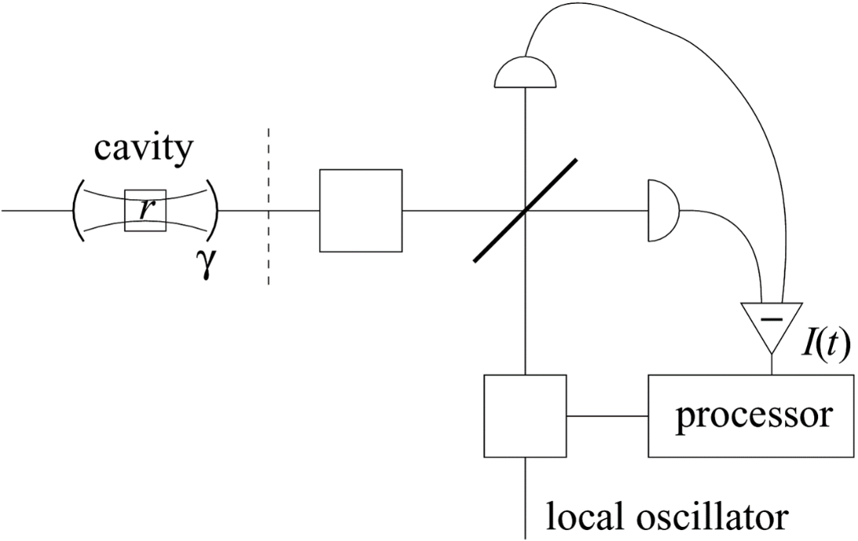
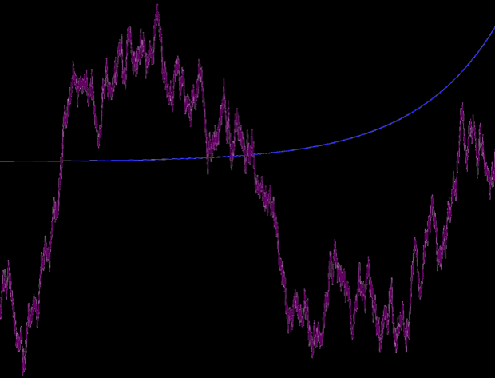
Measurement of fluctuating phase
$$φ\left(t\right)−φ(t_{0})$$
negative exponential weighting
Wiener noise
$$φ$$
$$θ$$
Further back in time, the phase is further from the current phase.
For a more accurate phase measurement, data over a shorter time interval must be used.
This results in worse scaling than for a constant phase.
Constant vs varying
Coherent states:
Squeezed states:
Optimal squeezing:
$$Δφ∝1/\sqrt{N} vs Δφ^{2}∝1/\sqrt{N}$$
$$Δφ∝e^{−r}/\sqrt{N} vs Δφ^{2}∝e^{−r}/\sqrt{N}$$
$$Δφ∝\ln{N}/N vs Δφ^{2}∝1/N^{2/3}$$
$Δφ∝\ln{N}/N vs Δφ^{2}∝\ln{N}/N$?

Slide 6
Types of phase correlations
$$\tilde{Σ}(ω)$$
Consider the spectrum of the signal
$$Σ\left(t−t^{′}\right)=〈{\left[φ\left(t\right)−φ\left(t^{′}\right)\right]}^{2}〉$$
We allow the Fourier transform to have power law
$$\tilde{Σ}\left(ω\right)∝\frac{1}{{|ω|}^{p}}$$
Examples:
White noise - $p=0$
1/f noise - $p=1$
Wiener noise - $p=2$
Constant phase - $p→∞$
$$ω$$
$$φ(t)$$
$$t$$

Slide 7
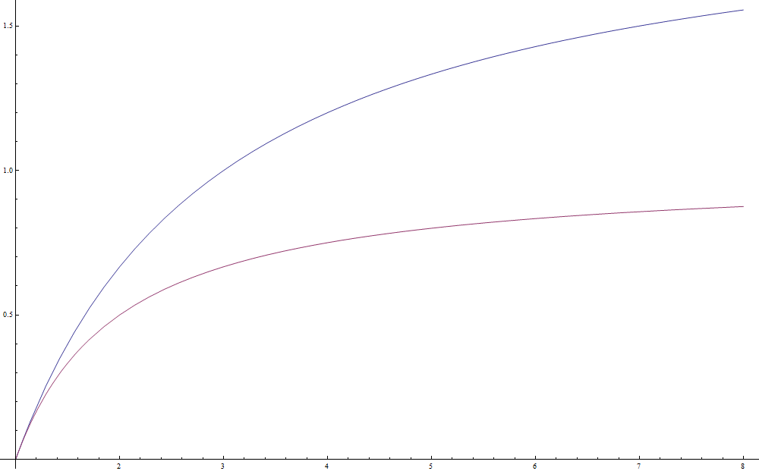
Our result
Three assumptions:
Beam is time-invariant
Phase spectrum scales as $1/{|ω|}^{p}$ for $p>1$.
Statistics are Gaussian & time-symmetric.
Result:
Stochastic Heisenberg limit is
$$Δφ^{2}≥{1/N}^{2\left(p−1\right)/(p+1)}$$
Standard quantum limit is
$$Δφ^{2}≥1/N^{\left(p−1\right)/p}$$
power of $N$
Limit $p→∞$ gives constant phase and $Δφ^{2}≥1/N^{2}$ vs SQL of $Δφ^{2}≥1/N$
For $p=2$ we get
$Δφ^{2}≥1/N^{2/3}$ vs SQL of $Δφ^{2}≥1/N^{1/2}$
$$p$$

Slide 8
Cramér-Rao bound
The variance is lower bounded by
$$Δφ^{2}≥F^{−1}(t,t)$$
$$F\left(t,t′\right)=F_{Q}\left(t,t′\right)+F_{C}(t,t′)$$
Inverses are interpreted in a matrix sense.
$$\int{dt^{′′} F^{−1}\left(t,t^{′′}\right)F\left(t^{′′},t^{′}\right)}=δ(t−t^{′})$$
photon number correlations
$$F_{Q}\left(t,t′\right)≔〈Δn\left(t\right)Δn\left(t′\right)〉$$
inverse of phase correlations
(for Gaussian case)
$$F_{C}\left(t,t^{′}\right)=Σ^{−1}(t,t^{′})$$
M. Tsang, H. M. Wiseman, and C. M. Caves, Phys. Rev. Lett. 106, 090401 (2011).

Slide 9
Properties of Gaussian states
The expression we want to lower bound is
$$\int{\frac{dω}{{\left|ω\right|}^{p}+{\tilde{F}}_{Q}\left(ω\right)}}$$
For Gaussian distributions
$$〈x_{1}^{2}x_{2}^{2}〉−〈x_{1}^{2}〉〈x_{2}^{2}〉=2({〈x_{1}x_{2}〉}^{2}−{〈x_{1}〉}^{2}{〈x_{2}〉}^{2})$$
This enables us to replace fourth-order moments with second-order moments, and get
$$F_{Q}\left(t−t^{′}\right)=4Nδ\left(t−t^{′}\right)+f\left(t−t^{′}\right)−g(t−t^{′})$$
$$f\left(0\right)=8N^{2}$$
$$N≥−4\tilde{g}(ω)$$
In terms of the spectrum
$${\tilde{F}}_{Q}\left(ω\right)=4N−\tilde{g}\left(ω\right)+\tilde{f}\left(ω\right)≤4\frac{1}{4}N+\tilde{f}\left(ω\right)$$
We have a sum of a bounded term
and a term with a bounded integral.
photon correlation spectrum
Net result is
$$Δφ^{2}≥\int{\frac{dω}{{\left|ω\right|}^{p}+{\tilde{F}}_{Q}\left(ω\right)}}≥\frac{1}{N^{2\left(p−1\right)/\left(p+1\right)}}$$

Slide 10
Spectral uncertainty principle
We need spectral uncertainty relations to get $N≥−4\tilde{g}(ω)$.
$${\tilde{S}}_{XX}(ω){\tilde{S}}_{YY}(ω)≥1$$
These are spectra of correlations.
$$S_{XX}\left(t−t^{′}\right)=〈X\left(t\right)X\left(t^{′}\right)〉$$
$$S_{YY}(t−t^{′})=〈Y\left(t\right)Y\left(t^{′}\right)〉$$
$$S_{XY}(t−t^{′})=〈X\left(t\right)Y\left(t^{′}\right)〉$$
We need tighter relation for correlations
$${\tilde{S}}_{XX}\left(ω\right){\tilde{S}}_{YY}\left(ω\right)≥{\left[\operatorname{Re}{{\tilde{S}}_{XY}(ω)}\right]}^{2}+1$$
We need to assume time symmetry to make ${\tilde{S}}_{XY}(ω)$ real.

Slide 11
Conclusions
We have proven a stochastic Heisenberg limit, for phase with power-law correlations.
We still need to assume Gaussian statistics – there is the open question of the general bound.
The usual Heisenberg limit appears as a special case of our general result.
The result is derived from an uncertainty principle for the spectra of the correlations.
D. W. Berry, M. J. W. Hall, H. M. Wiseman, arXiv:1306.1279

